Slide 1

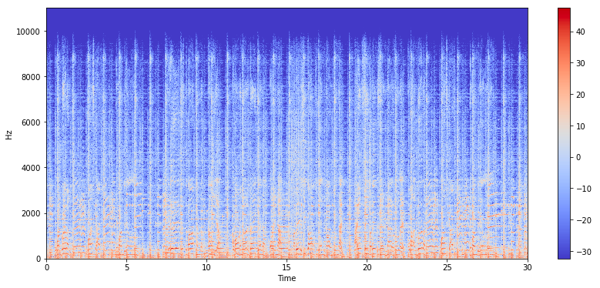
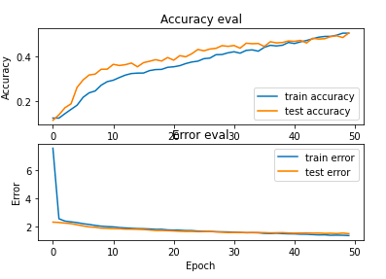
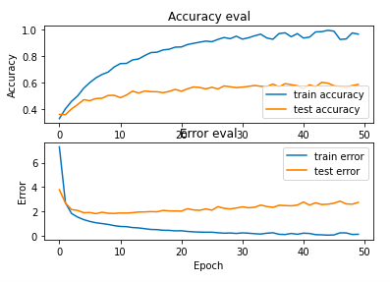
Convolutional Neural Networks for Music Genre Classification
Ashok Samarth Patil, Sachin M D, Sreelakshmi, Vatti Hemanth Kumar, V.Sai Teja
PES University
Abstract
Mel-Spectogram
CNN with Keras layers of Conv2D, MaxPool2D
Music plays a very important role in people’s lives. Music bring like-minded people together and it is the glue that holds communities together. Communities can be recognized by the type of songs that they compose, or even listen to. Deep convolutional neural networks (CNNs) have been actively adopted in the field of music information retrieval, e.g. genre classification, mood detection, and chord recognition. The purpose of our project is to find a better CNN algorithm than the pre-existing model that predicts the genre of songs. We have compared the performances of all these models and logged their results in terms of prediction accuracies. Few of these models are trained on the mel-spectrograms of the songs along with their audio features, and few others are trained solely on the spectrograms of the songs. It is found that one of the models, a convolutional neural network, which was given spectrograms of the dataset, has given the highest accuracy amongst all other models.
Methodology
We based our main architecture on a pre-trained GTZAN dataset.
Built a model using the concepts of ANN with Keras and sequential layers. The splitting ratio is 70:30
Used our most advanced model, using 3 convolution layers, each with its own max pool and regularization, feeding into 3 fully connected layers with ReLU activation, softmax output, and cross entropy loss.
Use Transfer learning model, to evaluate the model performance.
Conclusions
Across all models, using frequency based mel-spectrograms produced higher accuracy results. Whereas amplitude only provides information on intensity, or how “loud" a sound is, the frequency distribution over time provides information on the content of the sound. Additionally, mel-spectrograms are visual, and CNNs work better with pictures. The CNN performed the best, as we expected. It took the longest time to train as well, but the increase in accuracy justifies the extra computation cost.
Problem Statement
Goal:
1. To build a model which classifies music into its respective genre.
2. To compare the accuracies of the pre-existing and newly built models and draw the necessary conclusions.
Experimental Evaluations
ANN with Keras and Sequential Layers
Future Work
Datasets
A system is developed to classify musical pieces into genres(labels).
Additional feature reduction step is implemented to increase accuracy and precision of genre classifier.
It is found that some of the proposed features are not as effective as other features and lowers the overall genre classification quality.
Raw Data:
In this work, we make use of GTZAN Dataset, Raw Data is 1.2 GB and consists of 1000 audio files (.au) divided into 10 folders for 10 genres equally. I.e. every genre has 100 audio files.
Pre-processed data:
The raw audio has been converted to mel-spectograms and other features using librosa library for Machine Learning purpose and can be found in the folder as csv file. Feature spectrogram images are made from the audio files directly during training for Deep Learning model.
Contact
References
Patilashok248@gmail.com
sachin.gowdamd13037@gmail.com
mjshreelakshmii@gmail.com
hemanthkumar046@gmail.com
babbulusai7@gmail.com
[1] Hareesh Bahuleyan. Music genre classification using machine learning techniques.CoRR, abs/1804.01149, 2018.
[2] Mingwen Dong. Convolutional neural network achieves human-level accuracy in music genre classification.CoRR,abs/1802.09697, 2018.
[3] François Chollet et al. Keras.https://keras.io, 2015

